Slide 1
PROBLEM SOLVING AND PROGRAMMING USING PYTHON
Mr.Panduraju Pagidimalla
Assistant Professor, Dept of AIML
PhD, JNTU Hyderabad
MTech, JNTU Hyderabad
BTech, JNTU Hyderabad
10 years Experience in Research & Teaching
Best paper ward :5
International research publications : 7
Books:1
Book chapters:3
Patents:3

Slide 2
Techniques of Problem Solving

Slide 3
Introduction
Process: A process is a series of steps or activities that interact to produce a solution
Tools to document a process:
  Algorithm
  Flowchart
  Pseudocode
  Decision Table
  Decision Tree

Slide 4
Algorithms
Algorithms: is a finite sequence of steps defining the solution of a particular problem

Slide 5
Characteristics of a Good Algorithm
Input: an algorithm must have zero or more but a finite no. of inputs, which are externally supplied.
  Eg: find sum of first 100 natural numbers. (Zero inputs);
  find the sum of first n natural numbers (one input is required denoting the value for n)
Output: An algorithm must have atleast one desirable outcome, i.e., output
Definiteness (No ambiguity): Each step must be clear and unambiguous, i.e., having one and only one meaning
Finiteness: If we trace the steps of an algorithm, then for all cases, the algorithm must terminate after a finite no. of steps
Effectiveness: Each step must be sufficiently basic that it can in principle be carried out by a person using only paper and pencil. In addition, not only should each step be definite, but it must also be feasible
Note: An algorithm can be represented using a flowchart or pseudocode

Slide 6
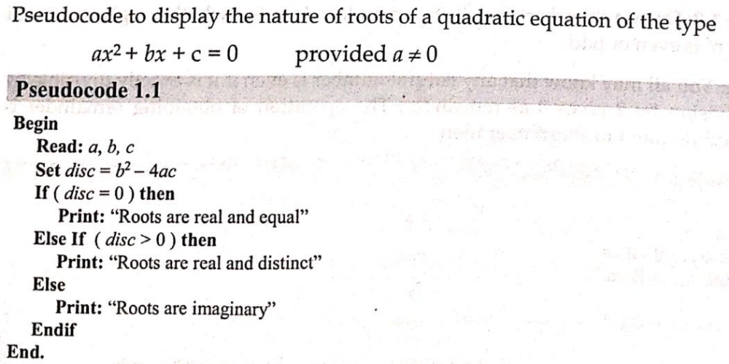

Slide 7
Flowchart
A flowchart is a pictorial representation of algorithm. It uses different shapes to denote different types of instructions.
These shapes are connected by directed lines to indicate the sequence in which instructions are to be executed.

Slide 8
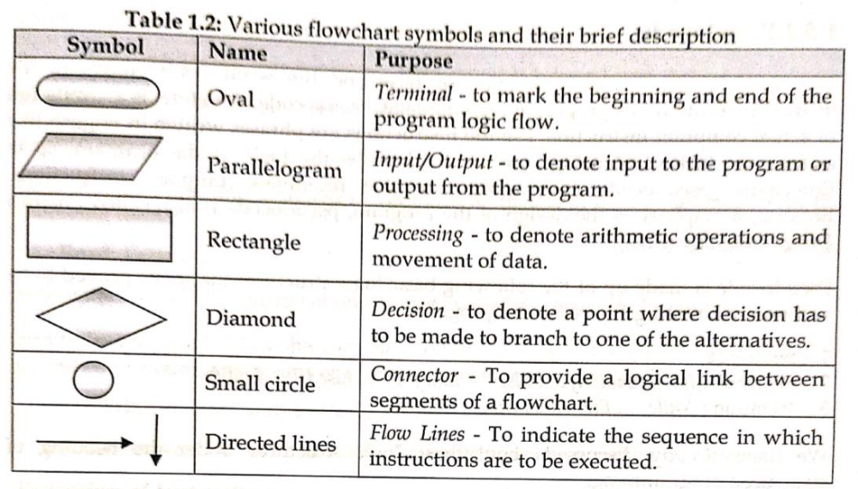

Slide 9
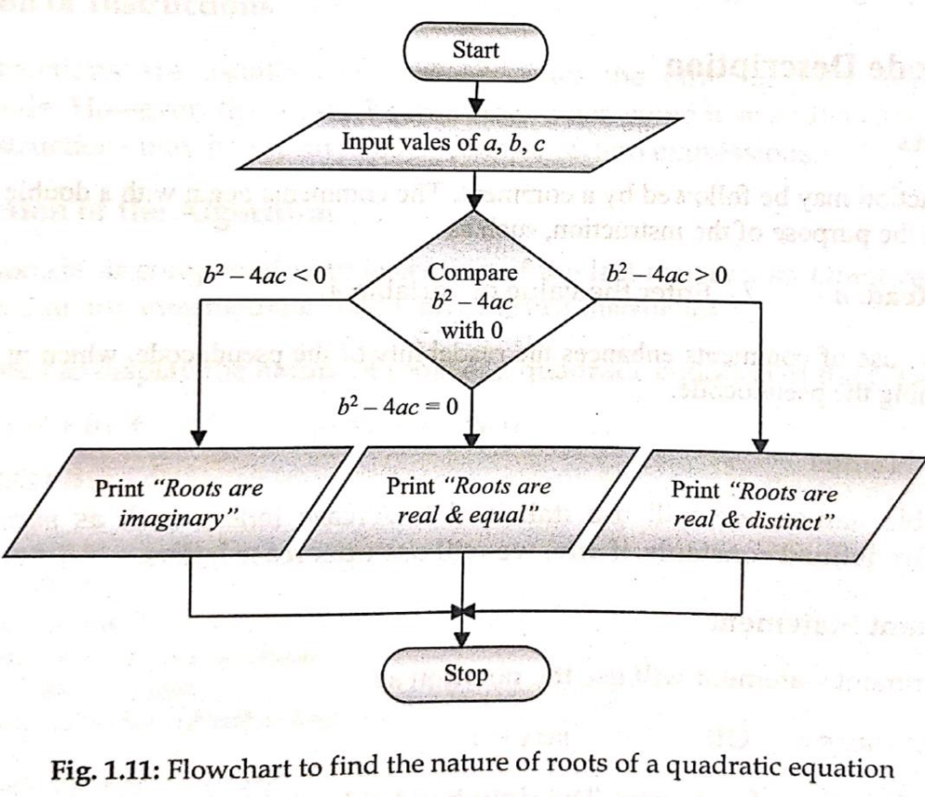

Slide 10
Exercise
Write algorithm (pseudocode) and flowchart to find largest of two numbers.

Slide 11
THANK YOU !

